Slide 1
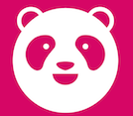
Foodpanda
Presentation By:
Mirza Kashif Ijaz
Muhammad Usman
Zain Khan
Anas Abid
Furqan Hameed
Foodpanda
Presentation By:
Mirza Kashif
M. Uman
Zain Khan

Slide 2
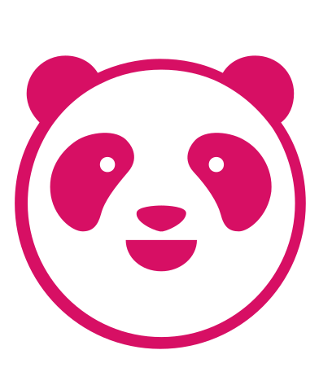
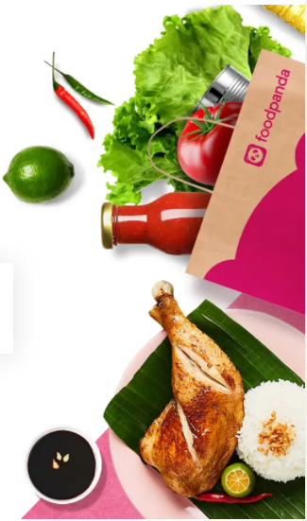
Introduction
Founded in March 2012 by Ben Bauer (CMO) and Ralf Wenzel (CEO)
Online food and grocery delivery platform owned by Delivery Hero
Headquartered in Berlin, Germany and operates in 14 markets
Users can order from local restaurants using the mobile app or the website
Partnered with over 115,000 restaurants
Processes and sends orders directly to partner restaurants, which then deliver to customers

Slide 3
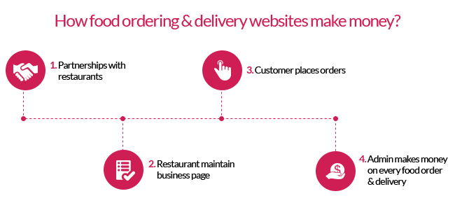
Business Model

Slide 4
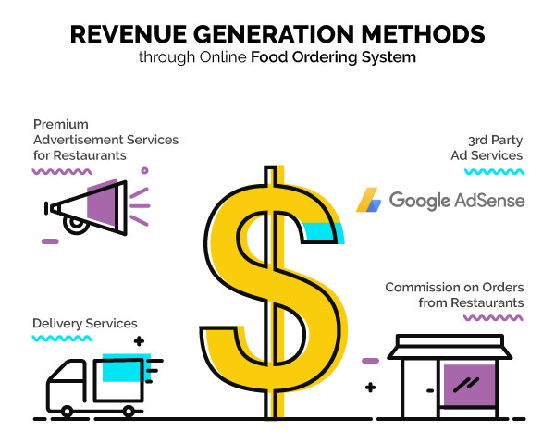
Revenue Model
Notes:
This is the revenue model for Foodpanda's core business of food deliveries which generates majority of it’s revenue.

Slide 5
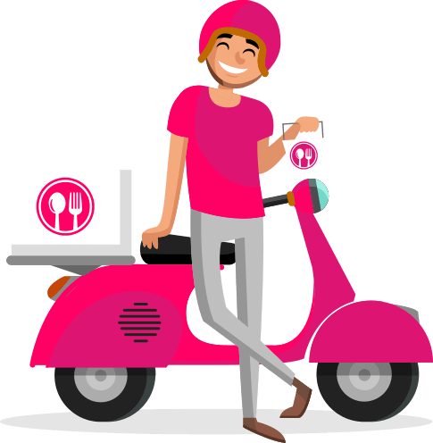
SWOT
Strengths
Good brand recognition
High Market Share
Easy to use application
Good offers
Home Kitchens
Trust of restaurants
Weaknesses
Can place order only from nearby restaurant
Not available in all parts of the country
Quite high commission charges
No control over service (Driver’s behavior)
Opportunities
Can expand in more areas of country
Increase market share
Enhance technology
Joint ventures with different brands
Partner with banks
Threats
High commission charges may cause damage
Change in buying power
Competitors increasing
Notes:
Strengths: Almost everyone in Pakistan who owns a smartphone have surely heard or used Foodpanda at least once. This shows how high brand recoronation Foodpanda has. Furthermore, being a pioneer in this industry also gives Foodpanda an advantage of having the highest market share in Pakistan as well. Moreover, the easy to use app of Foodpanda makes it easier to use for young as well as elderly people therefore having a wider range of target customers. Apart form all these strengths, having a huge brand name, Foodpanda also manages to attract banks for collaborations offering great deals to it’s customers. Foodpanda was also the pioneer and is still the only market player of Home Kitchens as well. Lastly, the trust level that local as well as international restaurants have on Foodpanda is surely a point of differentiation giving it a superiority on what it has to offer it’s customer over it’s competitors.
Weaknesses: Apart from all the strengths Foodpanda has, it also has some weaknesses too. For instance, customer are allowed to order just from restaurants in their vicinity only. Moreover, Foodpanda services is not available across Pakistan and is just limited to some parts of the country. Moreover, Foodpanda also receives criticism on charging unreasonably high commissions from it’s restaurant partners going up to 30%. Another weakness for Foodpanda is that the cannot control their drivers' behaviors which may lead to possibility of poor user experience damaging the brand image
Opportunities: Moving on to the opportunities, Foodpanda can turn some of it’s weaknesses to it’s opportunities. For instance, Foodpanda can expand in more areas of country enabling it to further increase it’s market share. Furthermore, Foodpanda can also take the advantage of new technological advancements such as 5G and Drone deliveries, etc. This could also assist Foodpanda in overcoming it’s weakness of driver’s behavior as discussed earlier. Moving on, Foodpanda can also partner with Banks to provide easy installment opportunities for it’s prospective riders increasing the number of riders which could ultimately lead to faster deliveries. This would also compliment their current and future strategy of q commerce.
Threats: Talking about the Threats, the main threat to Foodpanda is that their platform is quite easy to replicate and since the barriers to entries are very low this could lead to high competition in the future. Furthermore, since the overall economic conditions are getting worse day by day, this could lead to lower overall orders from customer leading to a loss in it’s revenue. And lastly, high commission charges may cause damages to Foodpanda's revenues as the restaurants might shift to other competitors who charge them a lower commission cuts.

Slide 6
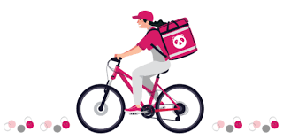
Porter's Five Forces
Used to access the level of Market Competition
Advantages:
Analyze industry trends
Recognize their opportunities
Recognize their risks
Threat of new entrants, threat of substitutes, bargaining power of customers, bargaining power of suppliers, and competitive rivalry

Slide 7
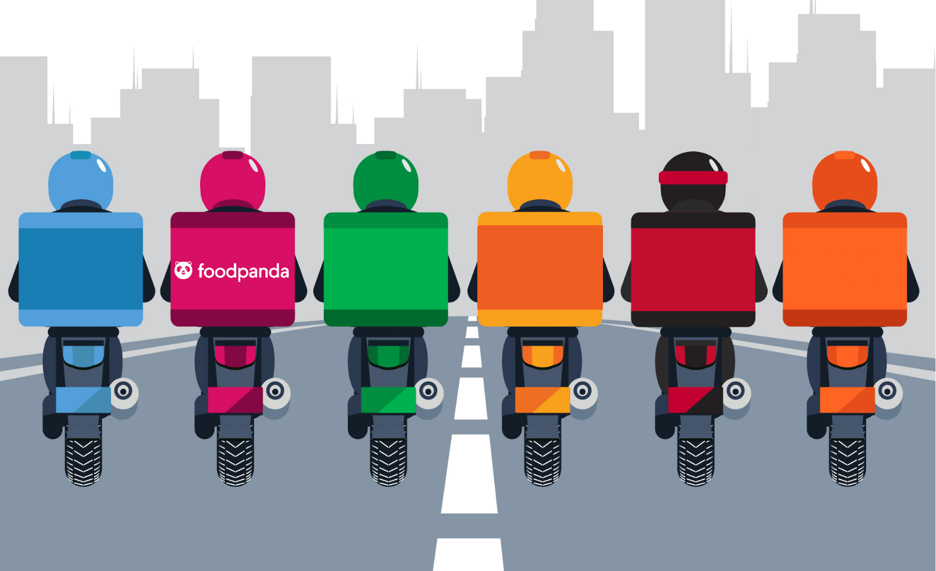
Porter's Five Forces
Industry Rivalry
Consists of number and variety of competitors and differences in products and quality
Competition is low
Ahead of competition
Threats of New Entrant
How easily competitors can enter the market
Trust by Partners (Restaurants)
Difficult to Enter
Economies of scale
Cost of App

Slide 8

Porter's Five Forces
Threats of Substitutes
Easier availability of product makes it easier
High substitution threat
Consumers can shift as competitor exist
Promotional offers can decrease this risk
Bargaining Power of Customer
Price changes affect customers' buying decisions and their ability to lower market prices
Moderate bargaining power
No switching cost
Free App

Slide 9

Porter's Five Forces
Bargaining power of suppliers
Number and size of Suppliers
Low bargaining power
Many suppliers
Setup App and Legal expenses

Slide 10

PEST
Political
Political Instability
Taxation of MNCs
Economic
Income Levels
Covid-19 has driven up the valuation of online marketplaces
Easy financing for bikes
Social
Public more likely to order food delivery post Covid-19
Millennials and Gen-Z use food delivery apps very frequently
Technological
Social media growth
Food delivery via drones is gaining attention.
Notes:
Talking about Pest analysis i will start with polictal factors
First off the factors that effect are the taxation on
MNCs, and political instabilitly for eg recent
political procesions caused the delivery network to
suffer. roads blocked caused order delays and
order cancellation which directly effects the customer
satisfaction and the company.
Moving further talking about economic factors
Income levels effect Foodpanda greatly, in recent times
due to soaring inflation real income has fallen
which can lead to decline in orders.
Covid 19 has driven up the market valuation of
online market places
Foodpanda along with Wasl investment has
started offering easy financing for bikes for
riders and many other programs in country have
initiaded to provide easy financing for bikes to
riders.
talking about social factors i would like to
emphasize that people after the covid 19 are more
likely to order through delivery as it is more
convienient to them.
Gen z and Mellinials use food delivery apps very
frequently.
talking about Technological aspects of PEST analysis
it can be seen that social media influence is on the
rise and people are more keen towards convienience
and fooddelivery industry is also changing the norms with food
delivery through DRONES.Foodpanda keeps it app updated
continues to introduce new features such as the panda mart which
i will be discussing next.

Slide 11
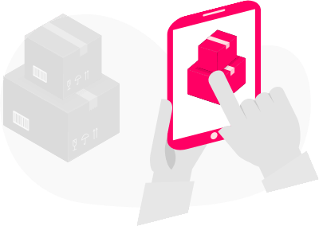
Current and Future Strategy
Quick Commerce:
Foodpanda, has set its focus on the next generation of e-commerce that is “Quick Commerce or Q-Commerce”. It is defined as delivering products to customers instantly and in small batchers, whenever and wherever they need them.
In 2021 they continued to expand this in many countries and launched this service in Pakistan under the name of “PandaMart” in the December of 2021.
They keep the concept of Quick Commerce as a “key strategic initiative” and plan on gaining the early mover advantage in this field as well.
Notes:
Foodpanda initiated a strategy that it currently follows and
plans on following in the future whhich is "Quick Commerce"
it is defined as delivering products to customers instantly
and in small quantities whereever and whenever they need them.
in accordance with this goal they launched "Pandamart" in pakistan
in december of 2021. they regard the concept of Quick commerce as a
Key Strategic initiative" and being the first one to launch this in
the delivery buisness they plan on gaining the first mover advantage.
The issue with this concept is that they have launched this woth
the same infrastructure of their ie the same riders who deliver food also
deliver pandamart items. Riders obvioulsy prioratize food orders as it might get cold
and deliver it first therefore delaying the orders of pandamart.
Now .......... will discuss proposed strategies.

Slide 12

Proposed Strategies
Foodpanda should consider opening centralized kitchens quicker than its competitors as it’s a great way to attract people in the offline world.
Food panda can acquire Cheetay which is a direct competitor. (Horizontal Integration)
Foodpanda can also offer delivery of prescription medicine by partnering up with different pharmacies.
New in-app features such as calorie count, top 10 most ordered meals of the week, and top-rated restaurants near you.

Slide 13
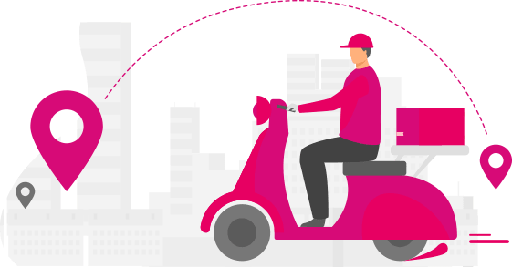
Best Strategy
The best strategy from the ones mentioned above would be the idea of centralized kitchens and they can name it ‘Panda Kitchen’. This would allow restaurants (or multiple restaurants) to prepare their food and deliver them to customers without having to open a new restaurant in that location entirely.
Notes:
Since Foodpanda already have the required infrastructure and brand personification along with strategic partnership with majority of the restaurants in Pakistan, utilizing their core capabilities such as brand recognition, high market share, resources, knowledge base in delivery industry, easy to use application and trust of restaurants, the best strategy from the ones mentioned above would be the idea of centralized kitchens which they can name as ‘Panda Kitchen’. This would allow multiple restaurants to prepare their food and deliver them to customers without having to open a new restaurant in that location entirely.

Slide 14
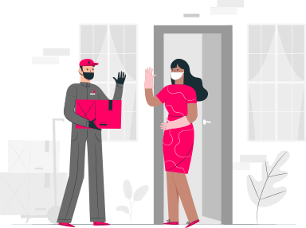
Implementation
They can adopt the ‘Blue Ocean Strategy’ by buying/renting a small space in an area where a lot of brands are not present but there is a high demand for them.
The brand image that Foodpanda has, it would be easier for them to get restaurants/partners to engage in those centralized kitchens and since no unnecessary space is required for sitting/parking etc.
It would be an easy and simple strategy to implement.
Notes:
Foodpanda can adopt “Blue Ocean Strategy” concept by buying/renting a small space in areas where a lot of restaurants are not present but there is a high demand for them. As the brand image that Foodpanda has, it would be easier for them to get restaurant partners to engage in those centralized kitchens. It would be an easy and simple strategy to implement. It would low cost and Foodpanda’s already established brand would make adoption very quick as it would just be an update in the app. Also, it could be integrated with current marketing strategy. It would be easier for Foodpanda to eliminate any threats competition as restaurants would be more comfortable in a well-recognized and trusted brand instead of a new errant. Furthermore, this would also make restaurants in partnership with Panda Kitchen exclusive to Foodpanda app users only therefore assisting in eliminating competition food delivery applications.

Slide 15
THANK-YOU!

